Slide 1

G2M insight for Cab Investment firm
Company Name : XYZ Location: US Team: Data and Analytics Date: 21-July-2023

Slide 2

Agenda
Executive Summary
Problem Statement
Approach
EDA
EDA Summary
Hypothesis Testing
Building Models
Recommendations

Slide 3
Description:
XYZ is a private equity firm in US. Due to remarkable growth in the Cab Industry in last few years and multiple key players in the market, it is planning for an investment in Cab industry.
Provide actionable insights to help XYZ firm in identifying the right company for making investment.
Cab Companies:
Yellow Cab
Pink Cab
The Analysis include :
Data Understanding,
Data Visualization,
Creating multiple hypothesis,
Building models and finding the best fit model based on Accuracy.

Slide 4
Data Preparation:
There are 4 datasets:
Cab_Data.csv – this file includes details of transaction for 2 cab companies.
Customer_ID.csv – this is a mapping table that contains a unique identifier which links the customer’s demographic details.
Transaction_ID.csv – this is a mapping table that contains transaction to customer mapping and payment mode.
City.csv – this file contains list of US cities, their population and number of cab users.

Slide 5
EXPLORATORY
DATA
ANALYSIS

Slide 6
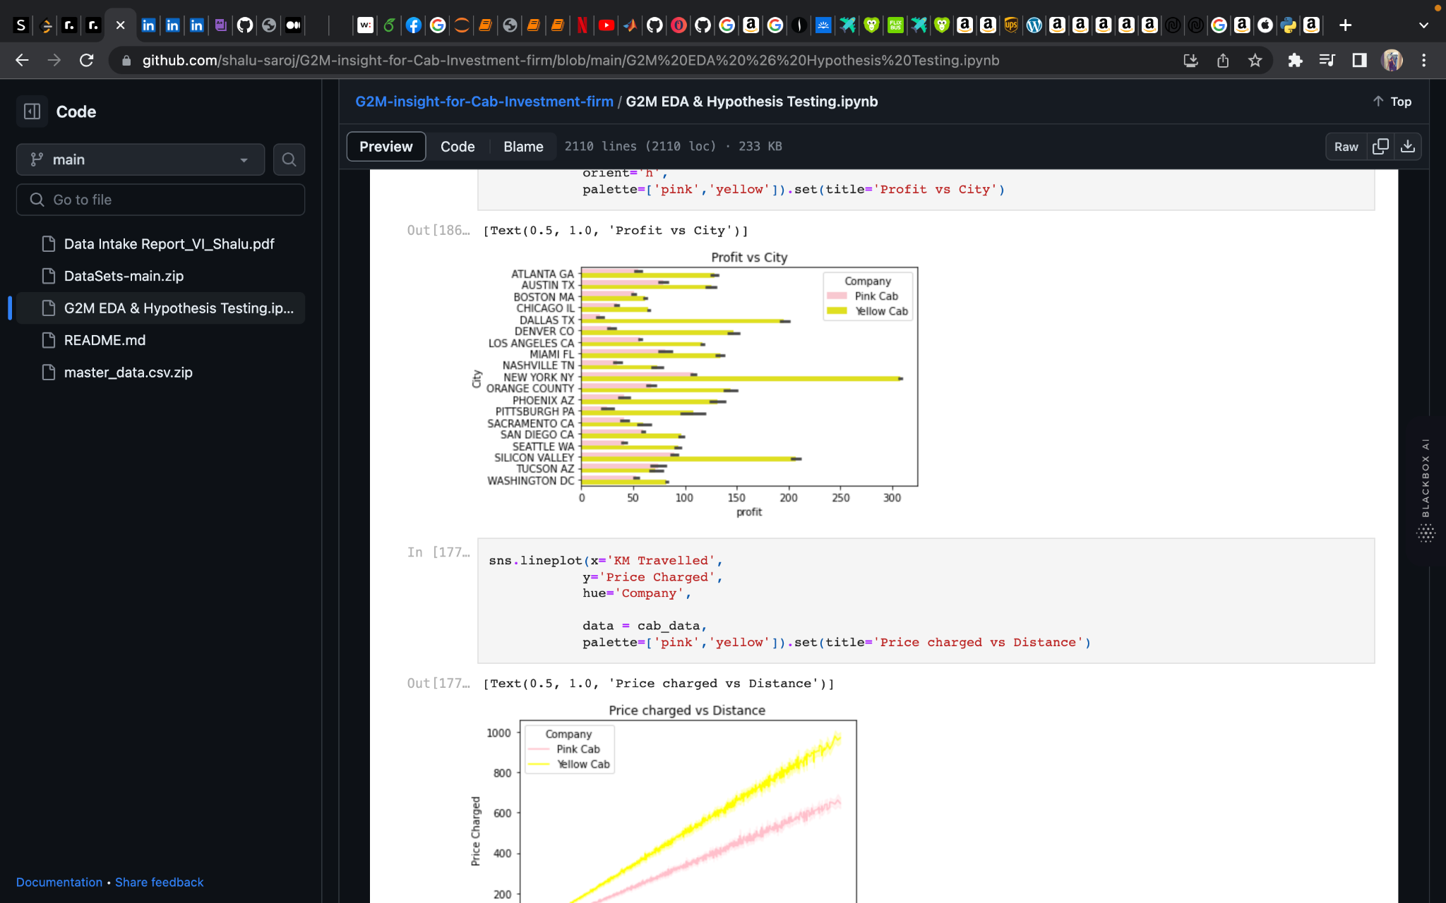
Distribution of Profit vs City:
From the above graph, we can see that for both Pink and Yellow Cab most of the rides are in the city of New York.

Slide 7
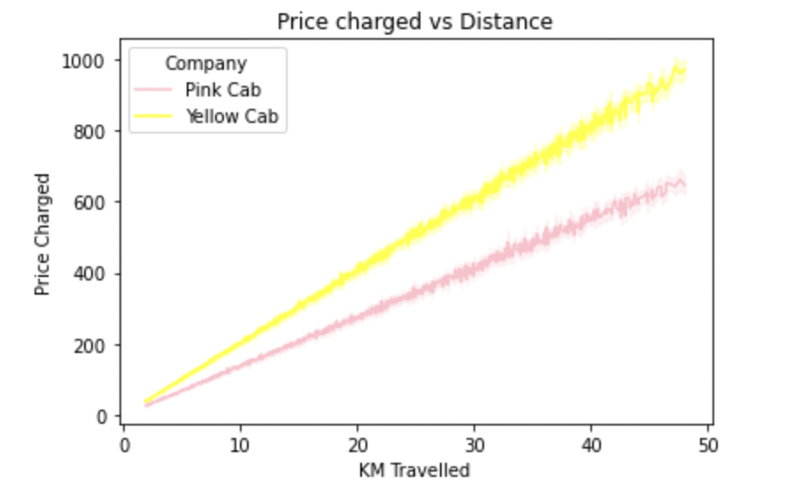
Distribution of Price Charged for both Cabs:
The Price charged range for Yellow cab is more than the Pink cab.

Slide 8
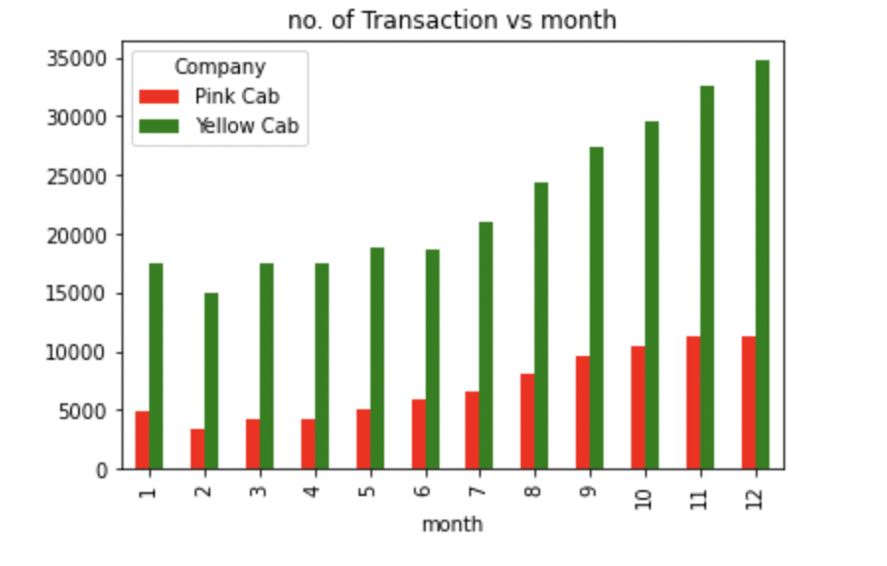
Travel Frequency per Month:
Yellow Cab has higher travels (35000) in the month of December which is the holiday season compared to Pink Cab (11000).

Slide 9
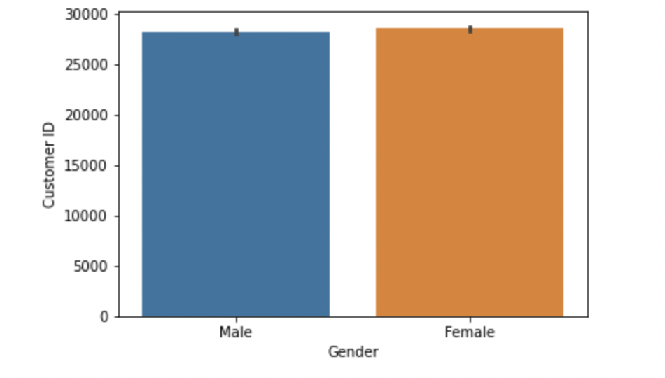
No. of Customers wrt genders:
From the graph it shows that the no. of male users is almost equal to no. of female users.

Slide 10
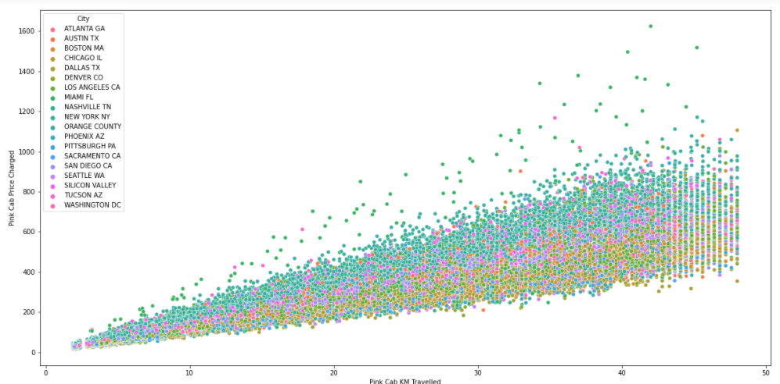
Pink Cab: Price Charged per KM per City
For Pink cab all the cities have the same increase in price charge with increase in distance

Slide 11
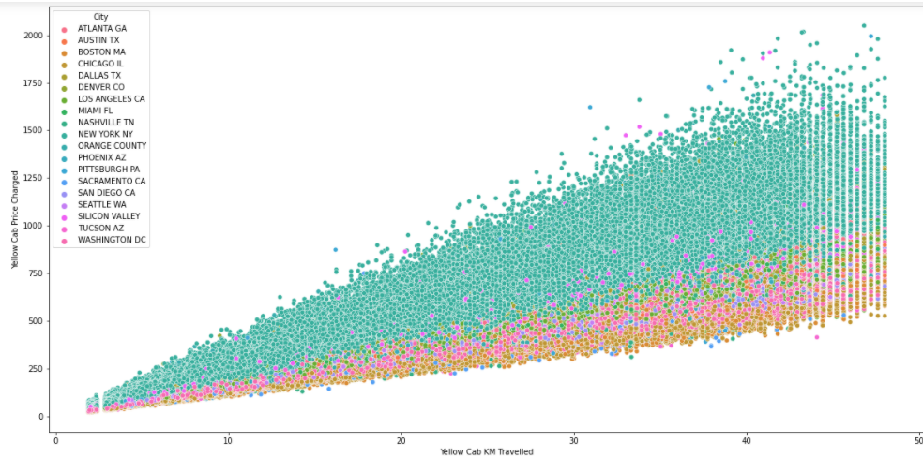
Yellow Cab: Price Charged per KM per City
In New York City the Price charged for Yellow Cab is more in comparison to the other cities

Slide 12
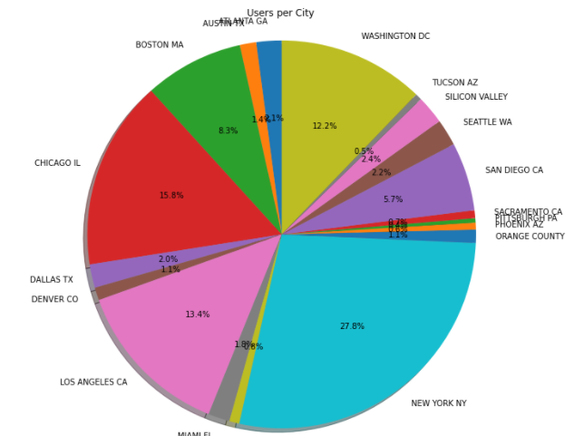
Cab Users per City:
New York City has the highest Cab users with 28% followed by Chicago with 16% and Los Angeles with 13%

Slide 13
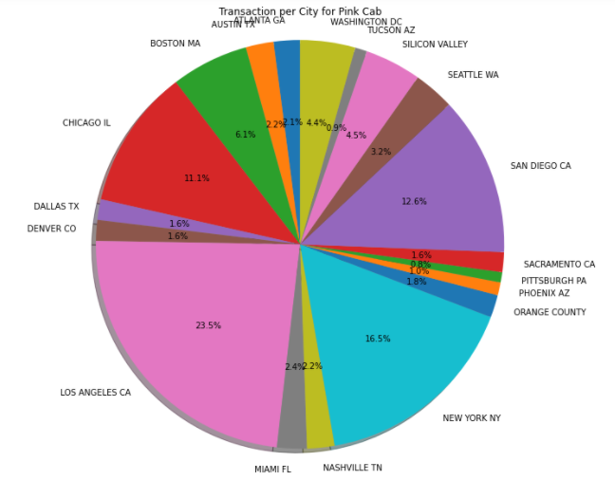
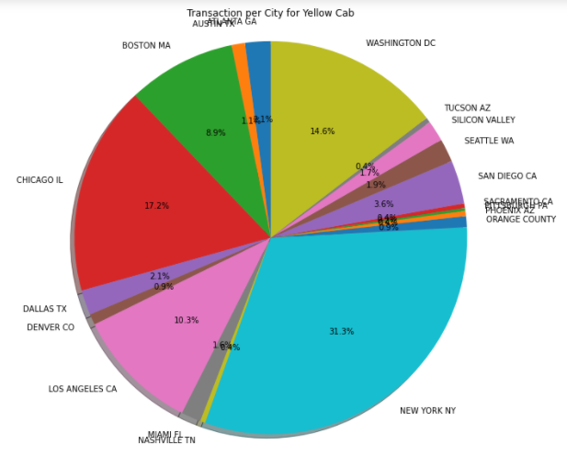
Transaction per City for both Cabs:
Transaction for Yellow Cab is highest in New York City(31%) and New York City has the highest Cab Users of 28% as per the previous slide.
Transaction for Pink Cab is highest in Los Angeles City.

Slide 14
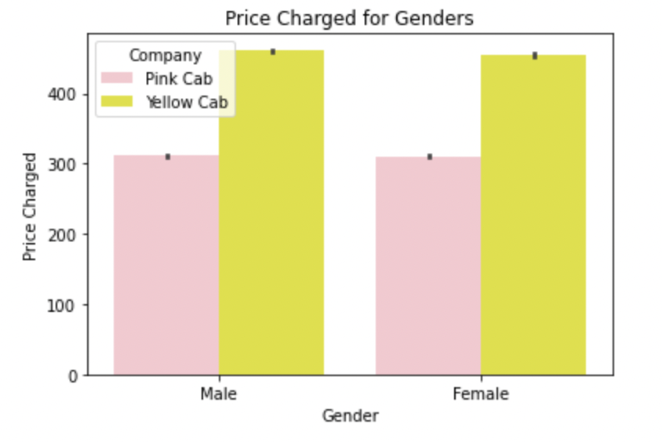
Price Charged per Gender for both Cabs:
Yellow Cab charge less from Female Customers whereas Pink Cab charges same for both Male and Female Customers.

Slide 15
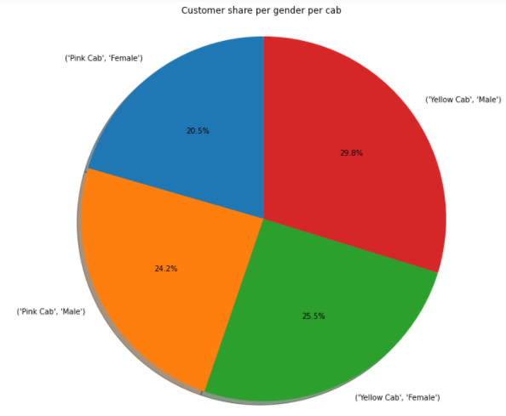
Customer Share per Gender for both Cabs:
Female Customers in Yellow Cab(25.5%) is higher compared to Pink Cab (20.5%)

Slide 16
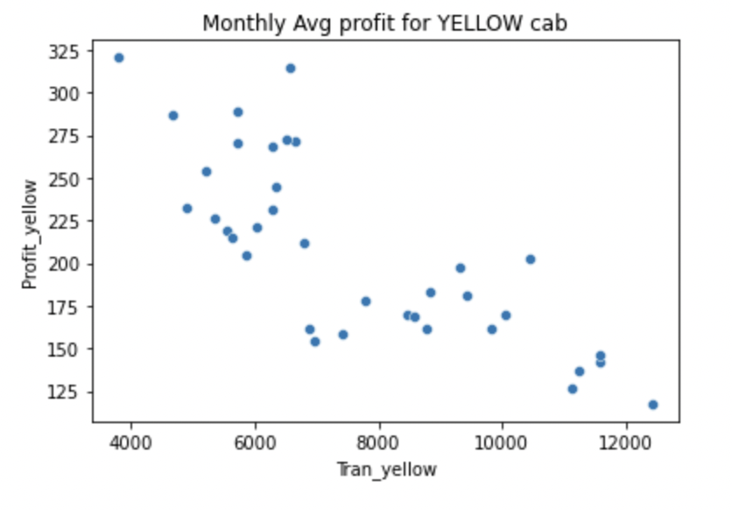
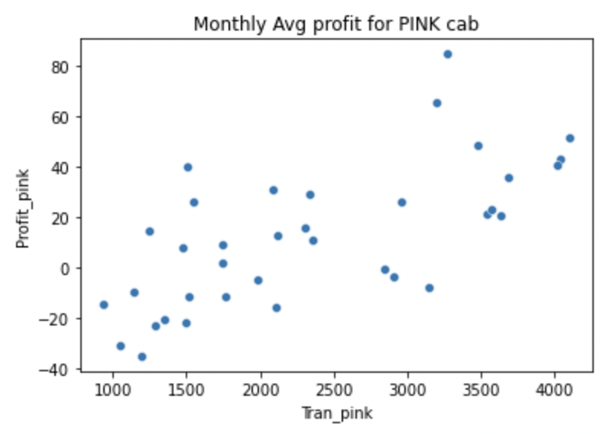
Profit Margin per month for both Cabs:
From the Graphs, it shows that the Yellow cab has a higher Profit Margin (Price Charged - Cost of Trip) compared to Pink cab.

Slide 17
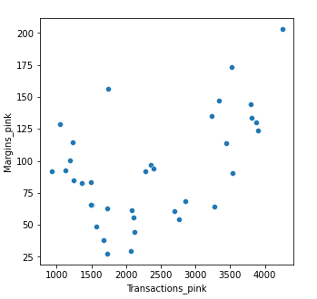
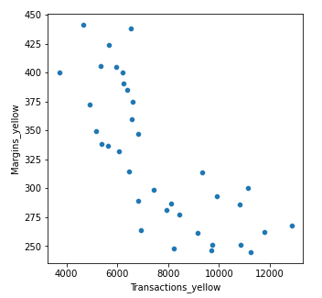
Margins per Transactions:
Margins: Price Charged – Cost of Trip
Pink Cabs increase margins with increase in number of Transactions.
Yellow Cab decrease Margins with the increase in Transaction.

Slide 18
EDA SUMMARY

Slide 19


In December which is the holiday season, no. of travels was around 11000.
In December which is the holiday season, no. of travels was around 35000.
Transaction per year:
2016: 20000 – 40000
2017: 20000 – 40000
2018: 20000 – 40000
Transaction per year:
2016: 80000 – 100000
2017: 80000 – 100000
2018: 80000 – 100000
All the cities have the same increase in price charge with increase in distance.
Pink Cab charges same for both Male and Female Customers.
In New York City the Price charged for Yellow Cab is more in comparison to the other cities.
Yellow Cab charge less from Female Customers.

Slide 20
Hypothesis Testing

Slide 21

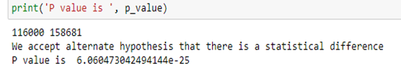



Slide 22
Recommendation
Transaction per year: For Yellow Cab Transaction per year from 2016 to 2018 is almost double than Pink Cab.
Margin per Gender: For Yellow Cab there is difference in Margin between Male and Female Customers due to which Female Customer percentage is higher in Yellow Cab in comparison to Pink Cab.
Profit Margin: For Yellow Cab the Profit Margin is higher per year from 2016 to 2018 in comparison to Pink Cab.
Yellow Cab decreases Margins with the increase in Transaction, hence for Yellow Cab the travel frequency during the Month of December which is the holiday season is 3 times more than Pink Cab.
Customers for Yellow Cab is highest in New York City which has the highest Cab Users of 28%.
On the basis of the above graphs, Yellow Cab is recommended for investment.

Slide 23
Submitted by: Shalu Saroj
Thank You

